Slide 1
AI/ML PROJECT
Team Members: Manan Jain (2210990551)
Manraj Singh (2210990560)
Mayank Bisht (2210990566)
Mayank Gupta (2210990567)
Project Name: House Rental Price Predictor
Faculty Coordinator: Shubham Singhal
:
Chitkara University Institute of Engineering and Technology,
Chitkara University, Punjab

Slide 2
Table of Contents
Objective
Introduction
Problem Statement
Methodology
Algorithm
Result
References/Links used

Slide 3
Objective
The objective of a House Rental Price Predictor is to accurately estimate or predict the rental price of residential properties based on various factors such as location, size, amenities, market demand, and other relevant features. This type of predictor can be useful for both landlords and tenants:
For Landlords:Helps landlords determine an appropriate rental price for their properties based on market trends and competition.
For Tenants:Allows tenants to compare rental prices across different properties and locations, aiding in decision-making.

Slide 4

Introduction
A House Rent Price Predictor is a powerful tool that leverages data analytics and machine learning to forecast rental prices for residential properties.
It provides valuable insights for individuals across various demographics, including job persons, old persons, and students.

Slide 5
Problem Statement
Problems faced by tenants and Landlords:
1.Market Volatility: Rental prices fluctuate due to changes in demand-supply dynamics.
2.Information Asymmetry: Landlords and tenants may lack access to comprehensive and up-to-date information regarding rental prices, leading to disparities in negotiation power and potentially unfair rental agreements.
3.Decision-Making Challenges: Both landlords and tenants face decision-making hurdles when setting or negotiating rental prices.

Slide 6
Methodology
1.Data Collection:Gather a diverse dataset containing both genuine news articles and fake news articles from reputable sources and datasets.
2.Feature Extraction:Optionally, include metadata features such as publication date, author information, and user engagement metrics.
3.Model Selection:Experiment with various machine learning and deep learning algorithms available in scikit-learn.
4.Model Training:Split the dataset into training, validation, and test sets using scikit-learn.Train the selected model using the training data.
•

Slide 7
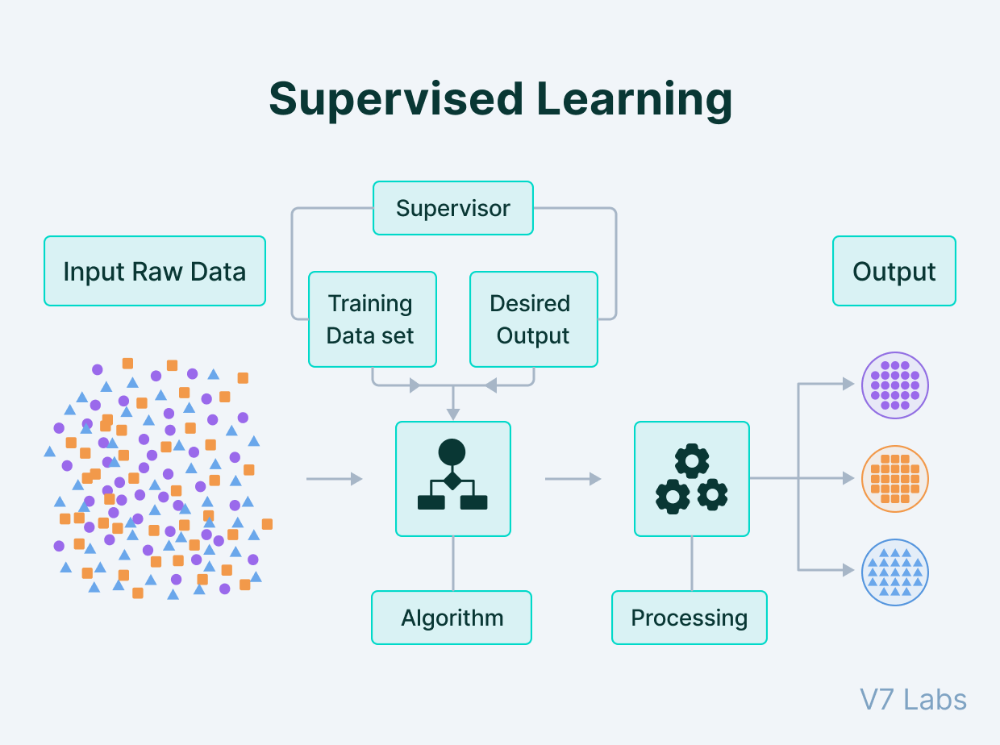
Which type of learning?
House rent price prediction,
involves supervised learning which means training a machine learning model using a dataset where each example consists of features related to a rental property along with the corresponding rent price.
The goal is to learn a mapping from the input features to the target rent prices so that the model can predict the rent price for new rental properties.

Slide 8
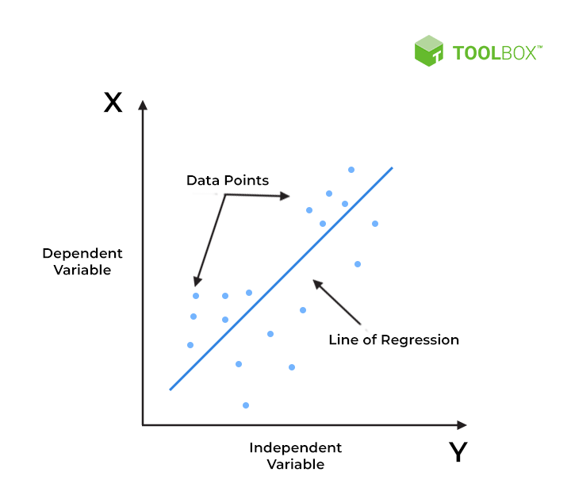
Which type of Supervised Learning?
Regression is a type of supervised learning algorithm used to predict continuous numerical values.
Here's how regression is applied to house rent price prediction:
1.Dataset Preparation
2.Data Preprocessing
3.Splitting the Data
4.Model Selection
5.Training the Model
6.Model Evaluation
7.Prediction

Slide 9
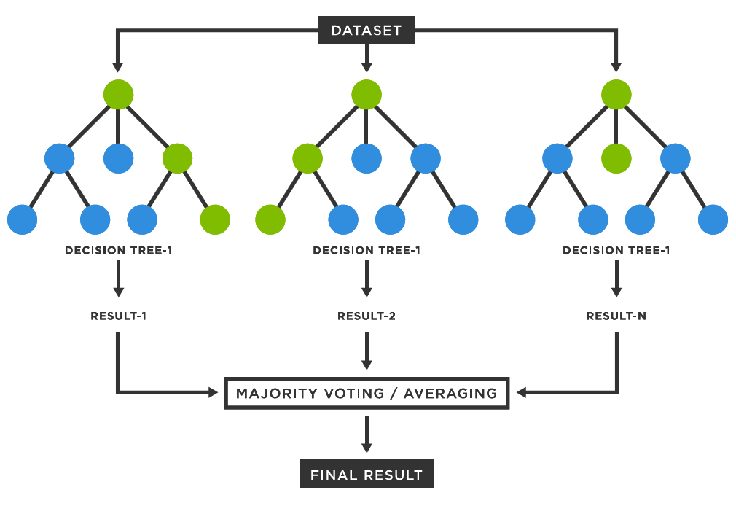
Algorithm
We used Random forest for the prediction of house rent price.Random forest are indeed a popular choice due to their simplicity, interpretability, and ability to handle both numerical and categorical features effectively.
*Random forest
combination of multiple decision trees.

Slide 10
Algorithm
We choiced Random Forest as our algoithm for the following reasons:
1.Robustness to Overfitting: Random forests are less prone to overfitting compared to individual decision trees, making them suitable for datasets with noise or outliers, which is common in real estate data.
2.Handles Non-linearity and Interactions: House rent prediction often involves complex relationships between features like location, amenities, and property size. Random forests can capture non-linear relationships and interactions between features effectively.
3.Scalability: Random forests can handle large datasets efficiently and are parallelizable, making them suitable for training on datasets with many observations and features.

Slide 11
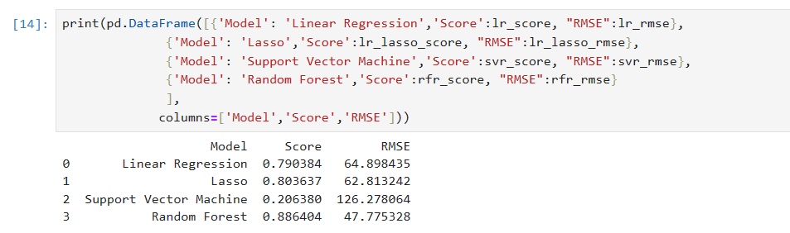
Result
Based on the results obtained from the evaluation of different regression models, including Linear Regression, Lasso Regression, Support Vector Machine (SVM), and Random Forest, it is evident that Random Forest outperforms the other models in terms of both predictive performance and model accuracy.

Slide 12
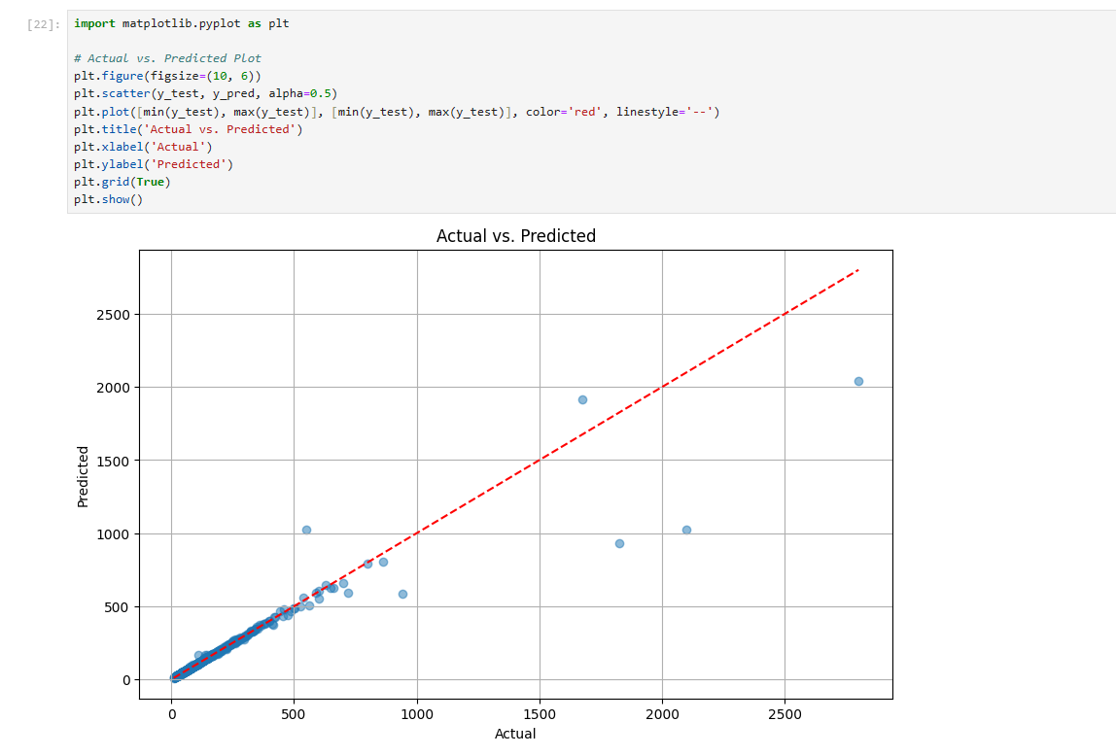
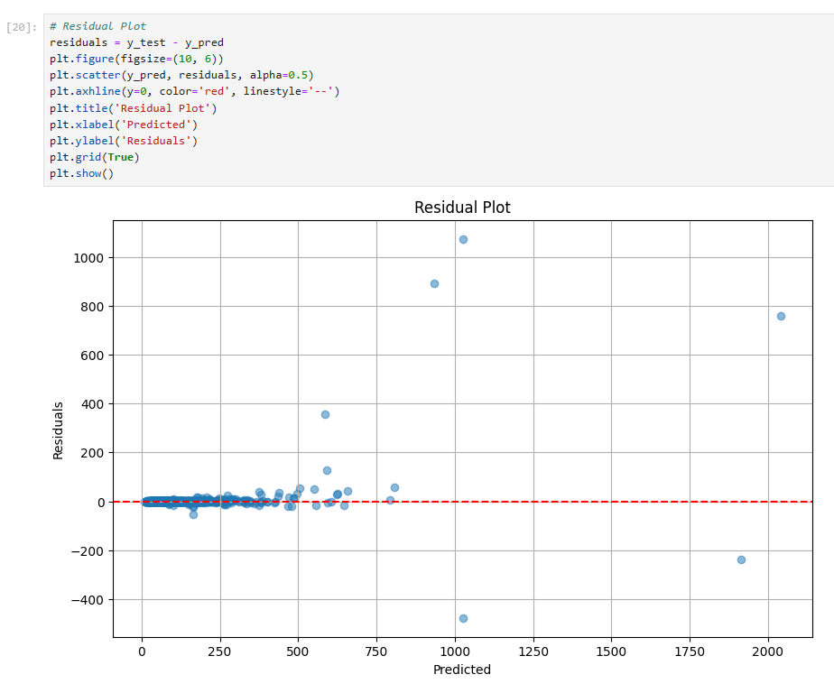
Visual Representation
•Actual Vs Predicted Plot
Residual Plot

Slide 13
References used
1.https://www.kaggle.com/datasets/amitabhajoy/bengaluru-house-price-data?resource=download
2.https://scikit-learn.org/
3.Copilot

Slide 14


